Slide 1
Lecture - 9

Slide 2

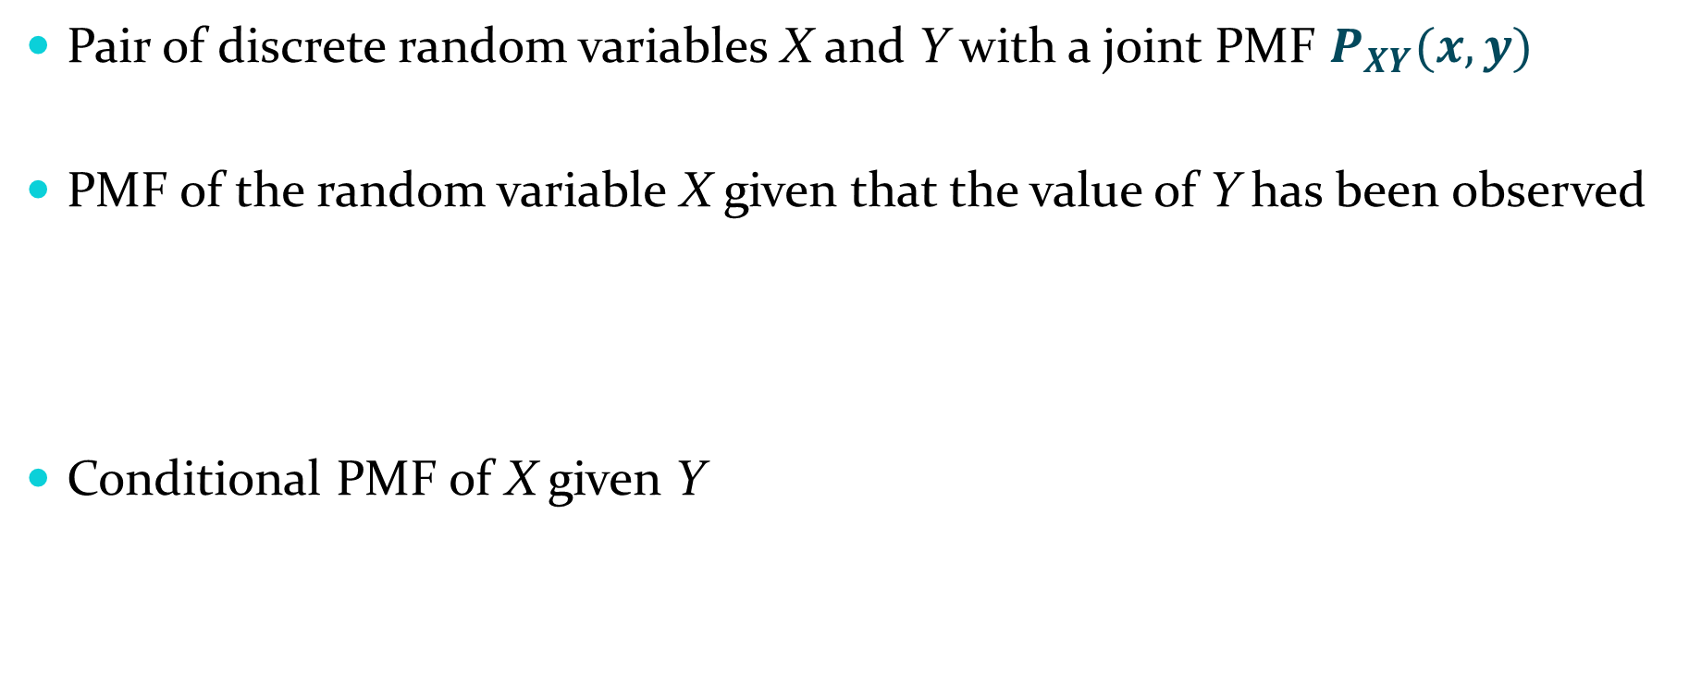
Conditional PMF
Pair of discrete random variables X and Y with a joint PMF $P_{XY}(x,y)$
PMF of the random variable X given that the value of Y has been observed
Conditional PMF of X given Y

Slide 3
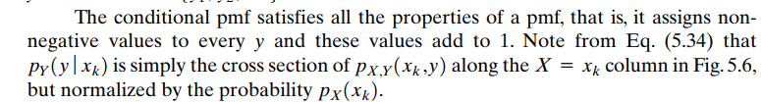
Remarks
Joint pmf can be expressed as the product of a conditional pmf and a marginal pmf

Slide 4
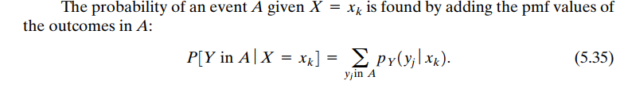
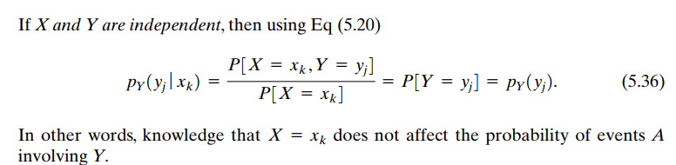

Slide 5
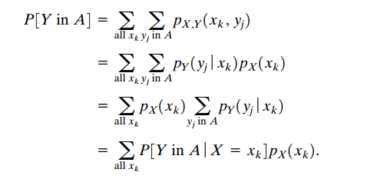

Slide 6
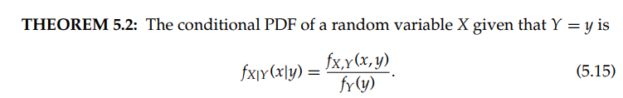
Conditional PDF

Slide 7
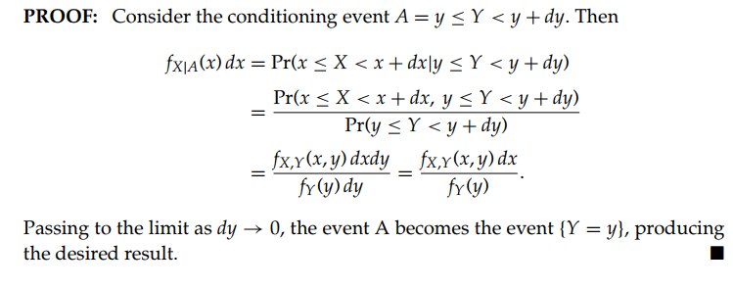

Slide 8
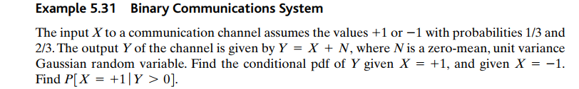
Ex:

Slide 9
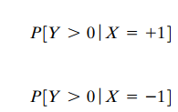

Determine

Slide 10
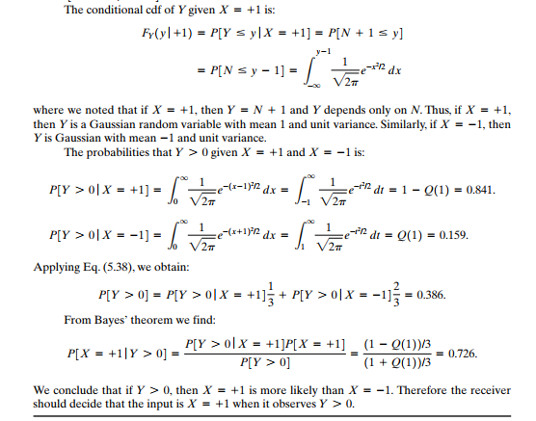

Slide 12
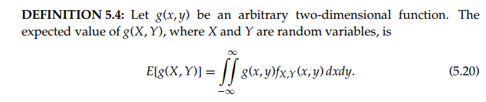



Slide 13
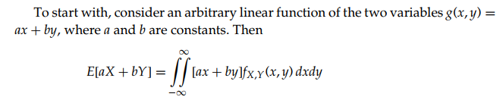
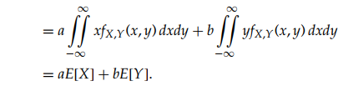

Slide 14
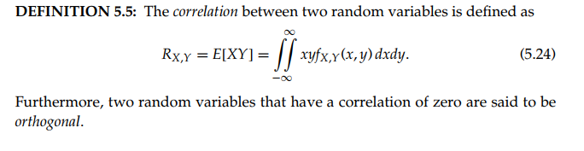

Slide 15
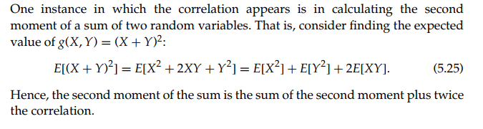

Slide 16
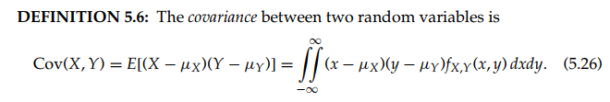

Slide 17


Slide 18


Slide 19
Covariance and Correlation Coefficient
The covariance between two RV’s X and Y is
Properties:
The correlation Coefficient of X and Y is
Notes:
When we are interested in the joint distribution of two random variables, it is useful to have a summary of how much the two random variables depend on each other. The covariance and correlation are attempts to measure that dependence.

Slide 20
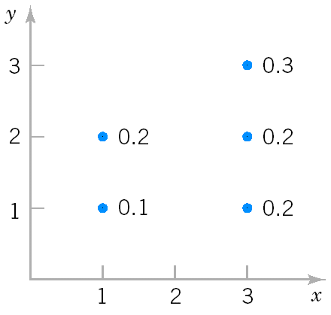
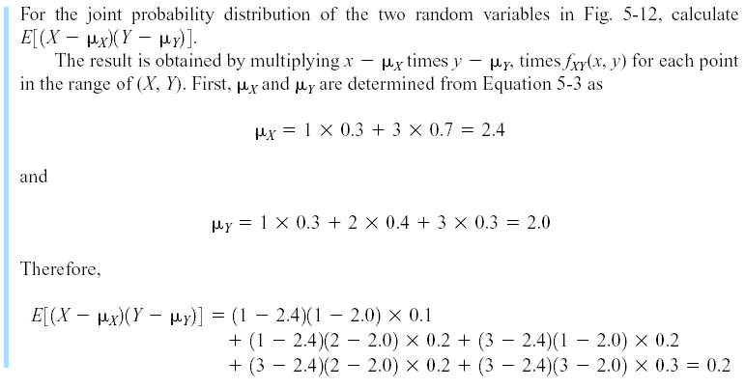
Covariance and Correlation (Example 6 (Cont.))
Marginal PMF
f_{X}(1)=P(X=1,Y=1)+P(X=1,Y=2)=0.1+0.2=0.3
f_{X}(3)= P(X=3,Y=1)+P(X=3,Y=2)+ P(X=3,Y=3)=0.2+0.2+0.3=0.7
f_{Y}(1)= P(X=1,Y=1)+P(X=3,Y=1)=0.1+0.2=0.3
f_{Y}(2)=P(X=1,Y=2)+P(X=3,Y=2)=0.2+0.2=0.4
f_{Y}(3)= P(X=3,Y=3)=0.3

Slide 21
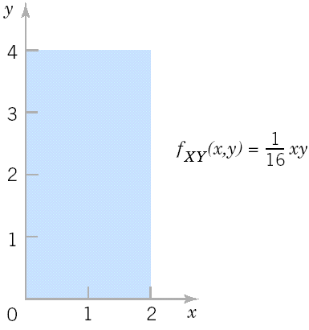
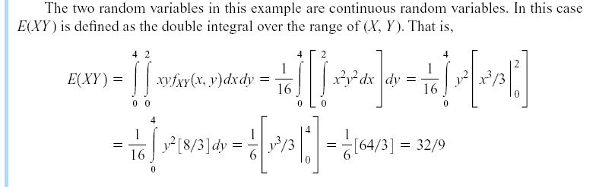
Covariance and Correlation
Example 9

Slide 22
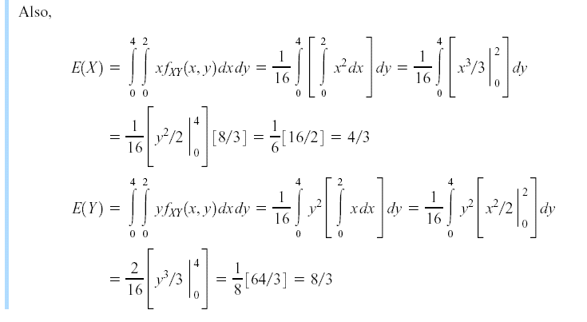
Covariance and Correlation
Example 9 (Cont.)

Slide 23
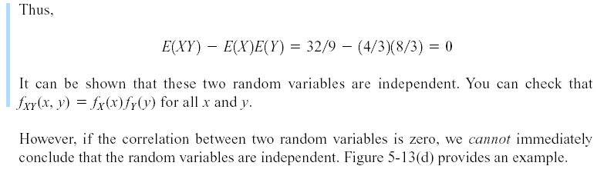
Covariance and Correlation
Example 9 (Cont.)

Slide 24
Zero Covariance and Independence
However, in general, if Cov(X,Y)=0, X and Y may not be independent.
Example 10: X is uniformly distributed on [-1,1], Y=X² . Then,
Cov(X,Y)= 0, but X determines Y, i.e., X and Y are not independent.
If X and Y are independent, then Cov(X,Y)=0.

Slide 25
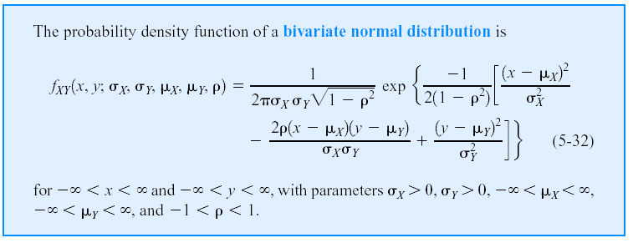
Bivariate Normal Distribution
Notes:
ρ: Correlation coefficient X, Y are independent if ρ = 0
The bivariate normal distribution is the joint distribution of certain linear combinations of independent random variables havign standard normal distributions. The bivariate normal distribution arises directly and naturally in many practical problems. For examle, the heights and the weights of the individuals in the population will be approximately a bivariate normal distribution.

Slide 26
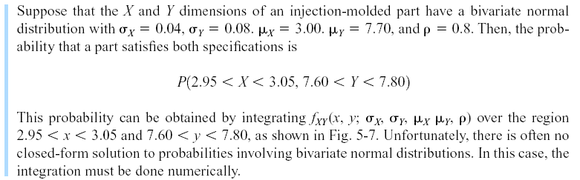
Bivariate Normal Distribution
Example 11
Notes:
Unfortunately, there is often no closed-form solution to probabilities involving bivariate normal distributions. In this case, the integration must be done numerically.

Slide 27
Bivariate Normal Distribution (Matlab)
y = mvncdf(xl,xu,mu,SIGMA) returns the multivariate normal cumulative probability with mean mu and covariance SIGMA evaluated over the rectangle with lower and upper limits defined by xl and xu, respectively. mu is a 1-by-d vector, and SIGMA is a d-by-d symmetric, positive definite matrix.
Examples 11 (Cont.)
mu=[3.00 7.70]; SIGMA=[0.0016 0.00256; 0.00256 0.0064];
XL=[2.95 7.60];
XU=[3.05 7.80];
>> p=mvncdf(XL,XU, mu,SIGMA)
p =
0.6975

Slide 28
Probability Distributions-II: Multidimensional Random Variables, DFs, Marginal Distributions, Discrete and Continuous Random Variables in two dimensions, Conditional Distributions, Transformation of continuous random variables in two dimensions. ● Mathematical Expectation-II: Expectation of Two-dimensional Distributions, Moments, Covariance and Correlation Coefficients, Conditional Expectations-Regression Curves, Principle of Least Squares-Regression Lines, M.G.F., Joint Characteristic Functions, Reproductive Property. ● Convergence of a Sequence of Random Variables and Limit Theorems: Convergence in Probability and Convergence in Distribution, Tchebycheff’s Inequality and Theorem, Bernoulli’s Theorem, Law of Large Numbers. Asymptotically Normal Distribution, Limit Theorem for Characteristic Functions, Central Limit Theorem, DeMoivre Laplace Limit Theorem. ● Some Important Continuous Distributions: Chi-square Distribution, t-Distribution, F Distribution and important statistics.

